Slide 1
Lecture 4: Content Delivery Networks (CDN)

Slide 2

CDN: Questions over reading
Ch. 10
Font families
Styling text
Font sizing
etc.
Ch. 11
HTML5 Shiv
Normalize CSS
Box Model
Changing Background

Slide 3
CDN: What & Why
CDN stands for “content delivery network” or “content distribution network”
A CDN allows for the quick transfer of assets needed for loading Internet content including HTML pages, JavaScript Files, Stylesheets, images, and videos
“CDN nodes are usually deployed in multiple locations, often over multiple backbones, Benefits include reducing bandwidth costs, improving page load times, or increasing global availability of content”.

Slide 4
CDN: When will we use them?
CDN are vastly important and one way you can implement them is within your own projects.
For example let’s take a look at Twitter Bootstrap
Twitter Bootstrap is/was an extremely popular framework for building Responsive Frontend websites and application.
Let’s build a page that brings in Twitter Bootstrap to demonstrate how you might do this without the assistance of a CDN

Slide 5
CDN: Demonstrate Twitter Bootstrap (TWBS)
Open class-directory
Create a new folder called Fonts inside of class-directory/assets/fonts
Create bootstrap.html file
Download Twitter Bootstrap
Unzip TWBS assets
Place the assets
bootstrap-3.3.7-dist/css/bootstrap.min.css >>> class-directory/assets/css
Don’t worry about JavaScript files
bootstrap-3.3.7-dist/fonts/* >>> class-directory/assets/fonts
The * means all the files
On Twitter Bootstrap site visit Components and paste in some examples

Slide 6
CDN: Manual file placement
With that example we had to manually go out to
Go to the website
Download the files
Unpack the files
Place the asset files
Code
That isn’t a ton of work in this example but what if
You had to do this for 30 different tools, plugins, etc.?
You are serving files from your server say in the US. What if your user is in China?

Slide 7
CDN: How do we implement?
Staying in class-directory
Create a new file bootstrap-cdn.html
Navigate to Twitter Boostrap “Getting Started”
Copy the first CDN link for CSS
Paste that link inside your HTML file in the <head>
Now in the <body> copy all the elements you had from bootstrap.html

Slide 8

CDN: FTW
As you can see with a single line of html and the power of CDN you
Go to the website
Download the files
Unpack the files
Place the asset files
Code

Slide 9
CDN: Loading Fonts
Custom fonts are a popular and fun way to make your website unique and give your site a bunch of personality
Many popular sites like
DaFont
FontSpace
Are great places to download and use custom fonts
For this demonstration we are going to load in a custom Google Fonts
Google Fonts is a great site to get amazing professional looking fonts simply and easily for any project

Slide 10
CDN: Manual loading of fonts
Open class-directory
Create a new html file called fonts.html
Go to Google Fonts and download a font
Unzip the file of the font you selected
Take that font file and place inside of class-directory/assets/fonts
Create a fonts.css file inside of class-directory/assets/stylesheets
Inside the CSS file link up @font-face rule for your downloaded font
Back to fonts.html link up fonts.css
Test

Slide 11


Slide 12
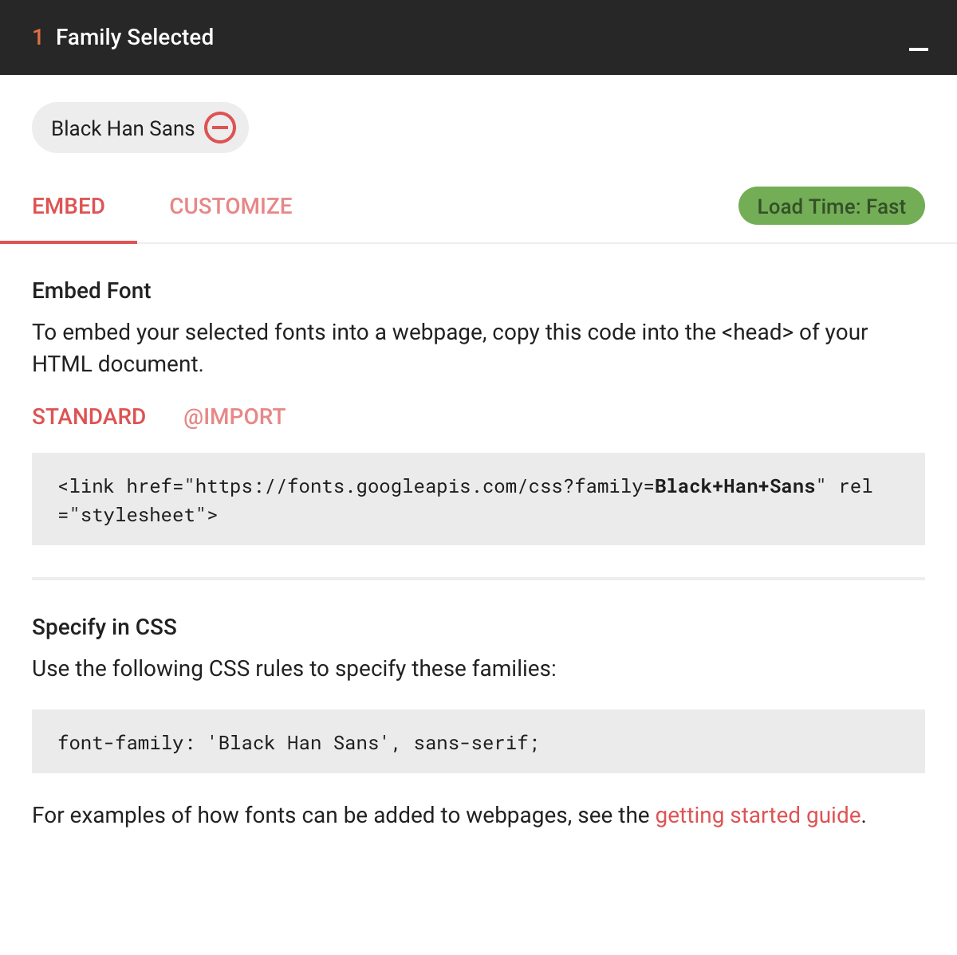
CDN: Load fonts by CDN
Create a file called fonts-cdn.html
Go back go Google Fonts
Select the font you had prior
Highlight the <link .../>
Paste link in <head> of your HTML file
Create a new CSS file
assets/stylesheets/fonts-cdn.css
Create a CSS rule and paste in the font family
View your code in the browser

Slide 13
CDN: Recap
Content delivery networks are the transparent backbone of the Internet in charge of content delivery
No matter what you do or what type of content you consume chances are it is being powered by some type of CDN
CDNs minimize the distance between users locations and the web servers allow for better performance
Spreads out your content so it is not in a single location

Slide 14

CDN: Homework
Reading:
Ch 12 & 14
Finish Designing pages
Media
Merch
Tour Dates

